Slide 1

Cloud Storage Application
A File Storage and Management System
By Sahil Gupta
T.Y. B.Sc. (C.S.)

Slide 2
Purpose & Objective
Purpose:
To develop a cloud-based application for storing, managing, and accessing files online.
To provide user with secure and reliable storage accessible from anywhere.
Objective:
To allow users to upload, download, and manage files efficiently.
To implement user authentication and data security.
To ensure data availability and easy file management

Slide 3
Scope
Supports file upload, download, and deletion.
Providers secure user authentication and access control.
Enable cloud-based data storage with centralized management.
Accessible through any web browser and devices.
Applications
Personal cloud storage for users.
Backup and recovery of important data.
File sharing platform.
Enterprise and business data storage solutions.

Slide 4
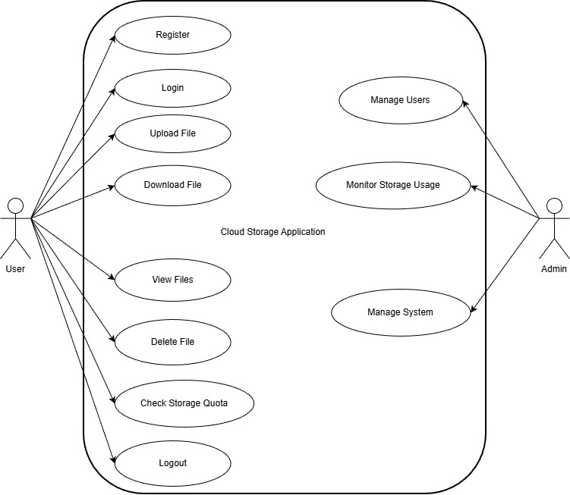
USECASE DIAGRAM

Slide 5
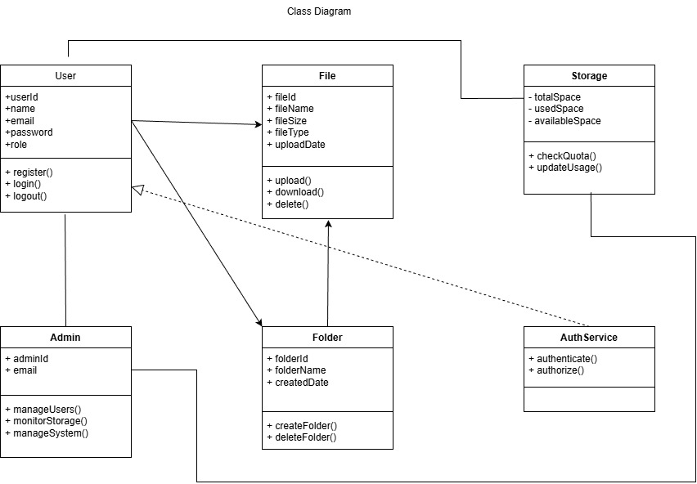
CLASS DIAGRAM

Slide 6
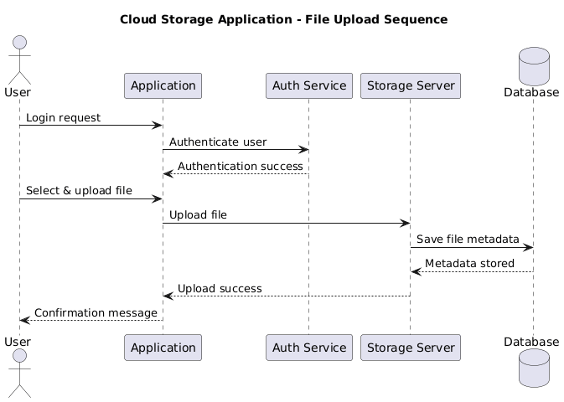
SEQUENCE DIAGRAM

Slide 7
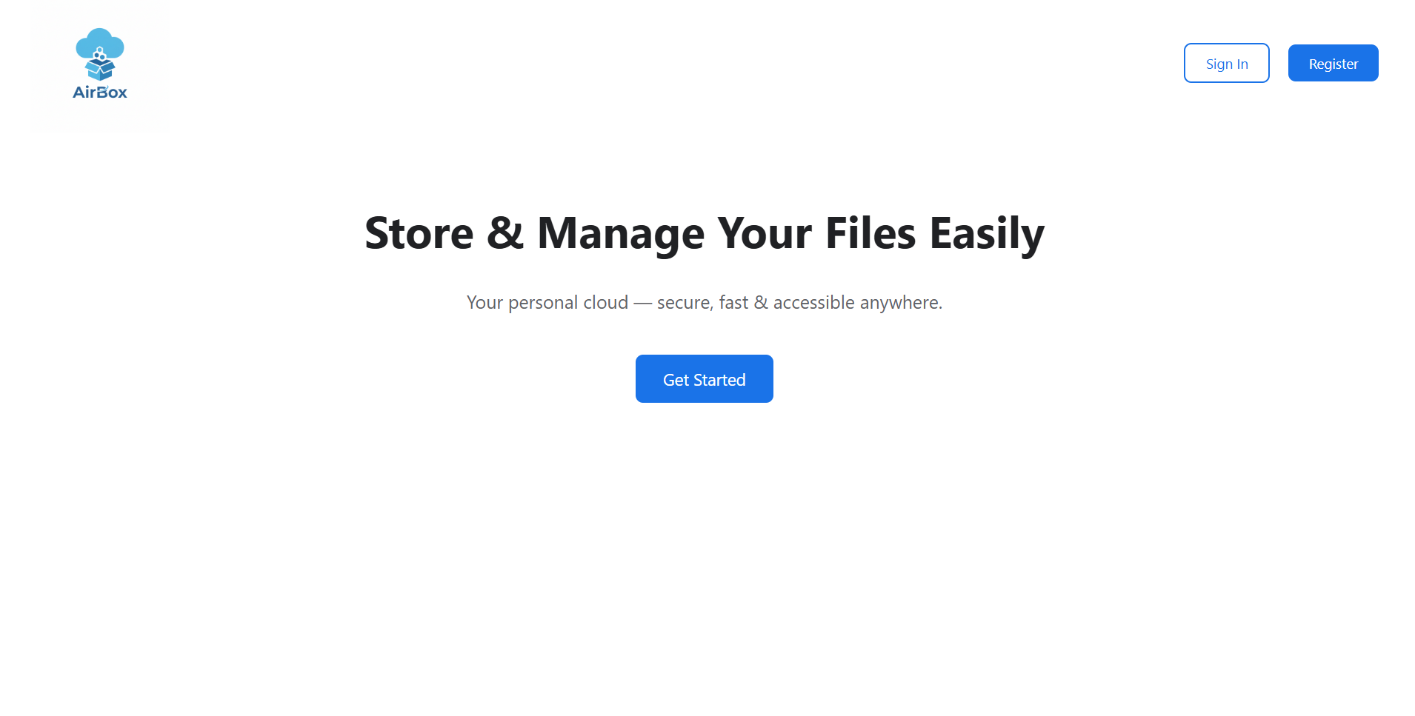
Home Page

Slide 8
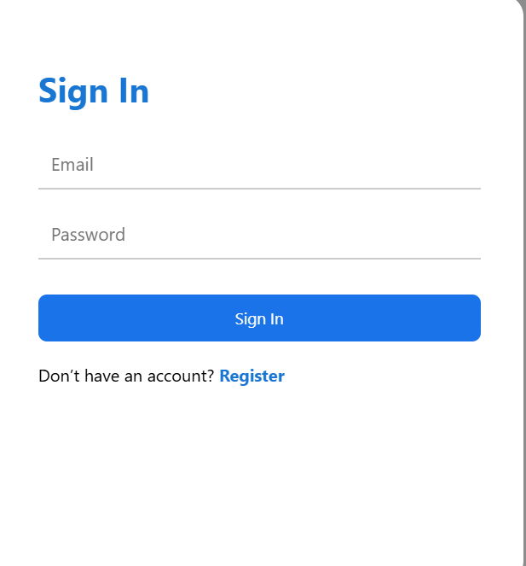
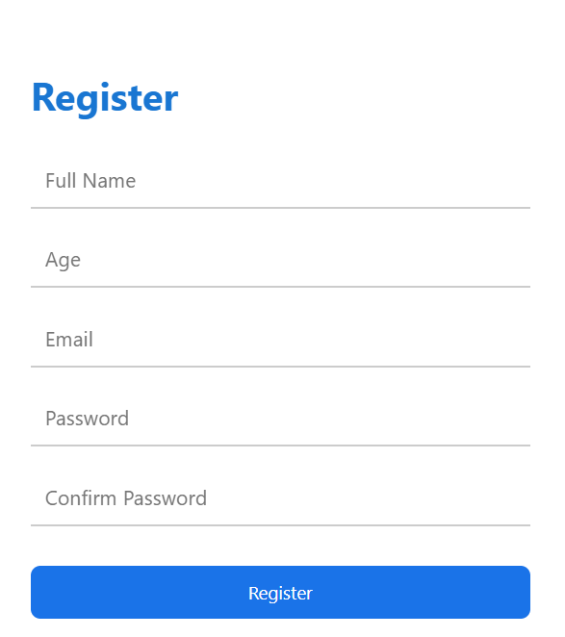
Login & Registration

Slide 9
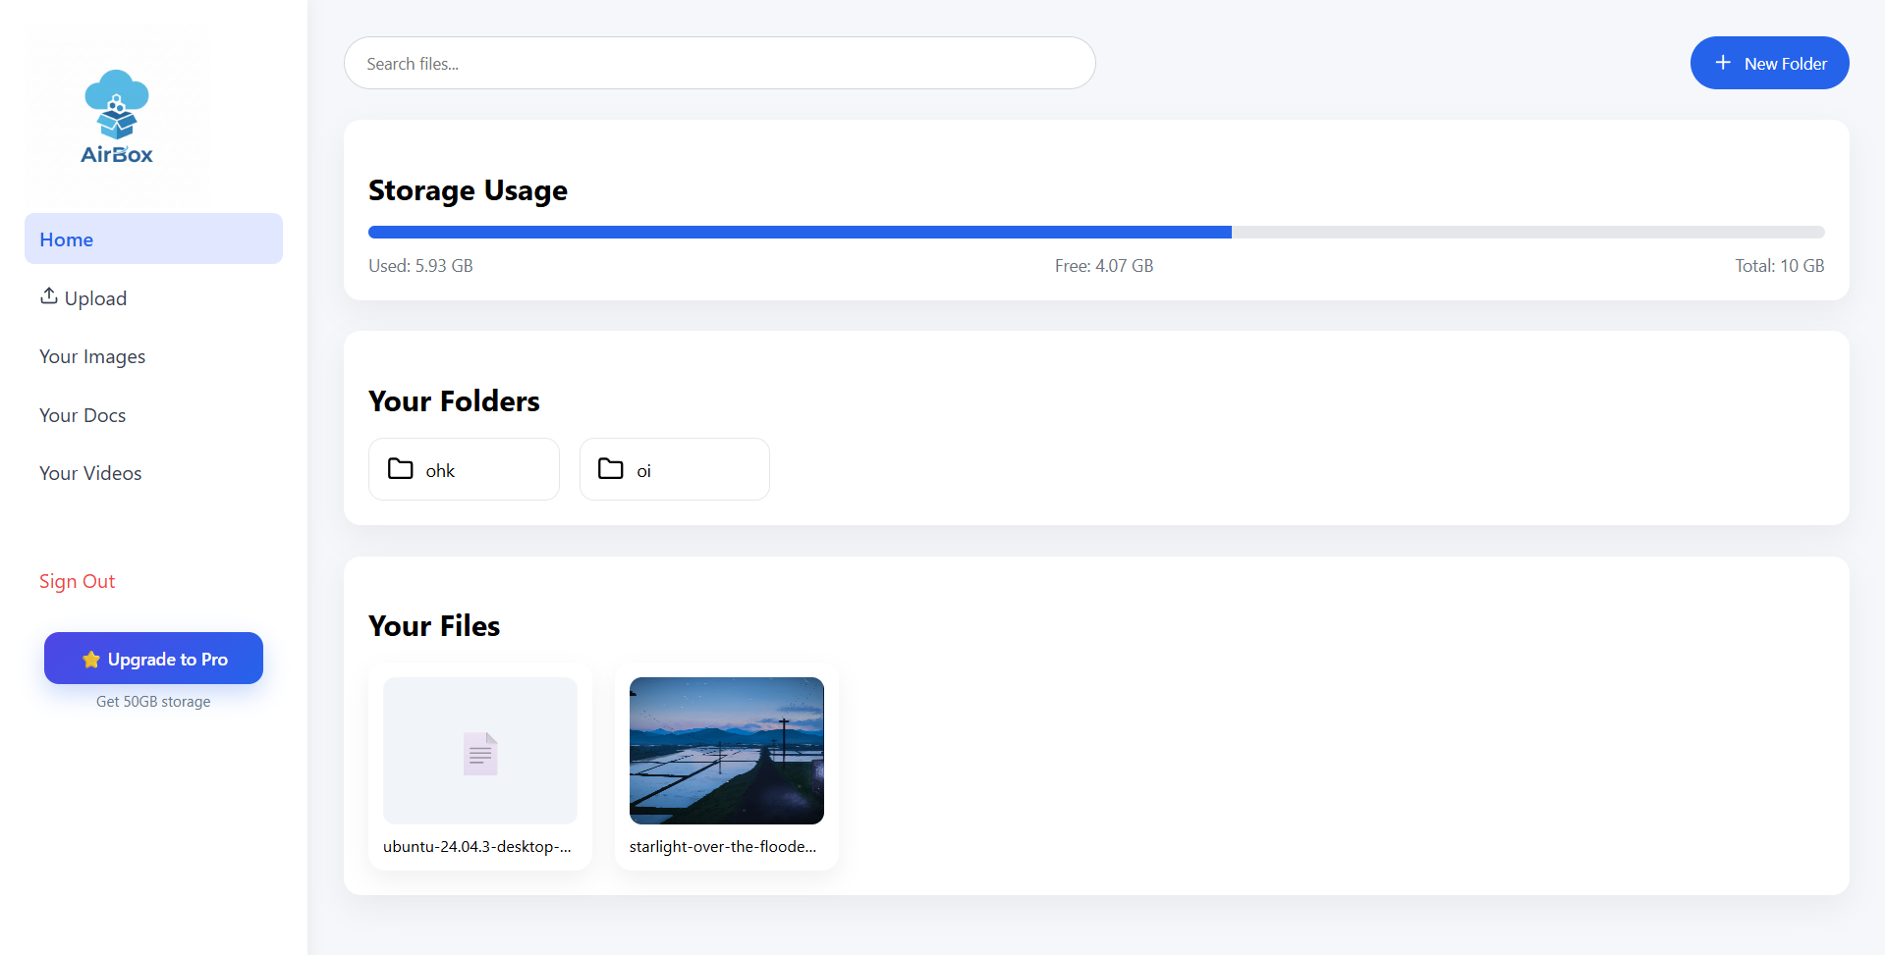
Dashboard

Slide 10
ADVANTAGES
Access files anytime and from anywhere.
Reduces the need for physical storage devices.
Centralized and secure data storage.
Scalable storage based on user requirement.
DISADVANTAGES
Requires a stable internet connection.
Security risks if encryption is not properly implemented.
Upload and download speed depends on network quality.

Slide 11
LIMITATIONS
Limited storage capacity based on allocated quota.
No or limited offline access to files.
Performance may reduce with large file sizes or heavy traffic.

Slide 12
CONCLUSION
The Cloud Storage Application provides a secure and efficient solution for online file storage.
It improves data accessibility, safety, and management.
The project demonstrates the practical use of cloud computing concepts.
Overall, the system is reliable, scalable, and suitable for real-world use.

Slide 13
FUTURE SCOPE
Integration of advanced encryption and security features.
Mobile application Integration.
Support for large-scale cloud infrastructure.
AI-based storage optimization and analytics.
Real-time file sharing and collaboration.

Slide 14
THANK YOU
By Sahil Gupta
T.Y. B.Sc.(C.S.)

